Slide 1
CST 402 - DISTRIBUTED COMPUTING

Slide 2
Module - II

Slide 3
Module – II Lesson Plan
L1: Logical time – A framework for a system of logical clocks, Scalar time
L2: Vector time
L3: Leader election algorithm – Bully Algorithm, Ring Algorithm.
L4: Global state and snapshot recording algorithms – System model and definitions.
L5: Snapshot algorithm for FIFO channels – Chandy Lamport algorithm.
L6: Termination detection – System model of a distributed computation
L7: Termination detection using distributed snapshots.
L8 : Termination detection by weight throwing, Spanning tree-based algorithm

Slide 4
Logical time
Causality between events - fundamental to design and analysis of parallel n distributed computing and operating systems
Causality -> usually tracked in physical time
In distributed systems, not possible to have global physical time;
Can realize only an approximation of it
As asynchronous distributed computations make progress in spurts, the logical time, which advances in jumps, is sufficient to capture the ordering associated with causality in distributed systems

Slide 5
Logical time
Causality (or the causal precedence relation) among events in a distributed system is a powerful concept in reasoning, analysing, and drawing inferences about a computation
Causal precedence relation among the events of processes helps solve a variety of problems in distributed systems such as :
Distributed algorithms design
Fair mutual exclusion algms, correct deadlock detection algms, consistency in replicated databases
Knowledge about the progress : useful in discarding obsolete info, gc and termination detection

Slide 6
Logical time
Tracking of dependent events
In debugging, helps to construct consistent states for resuming reexecution, helps build checkpoints in failure recovery, detection of inconsistencies in replicated databases
Concurrency measure
How many events are causally related ->concurrency in the computation
All the events not causally related can be executed concurrently

Slide 7
Logical time
The concept of causality is widely used by human beings, often unconsciously, in the planning, scheduling, and execution
In day-to-day life, the global time to deduce causality relation is obtained from loosely synchronized clocks (i.e., wrist watches, wall clocks).
In distributed computing systems, the rate of occurrence of events is several magnitudes higher and the event execution time is several magnitudes smaller.
Consequently, if the physical clocks are not precisely synchronized, the causality relation between events may not be accurately captured

Slide 8
Logical time
Network Time Protocols which can maintain time accurate to a few tens of milliseconds on the Internet, are not adequate to capture the causality relation in distributed systems.
In a distributed computation, generally the progress is made in spurts and the interaction between processes occurs in spurts
Causality can be accurately captured by logical clocks

Slide 9
Logical clock
In a system of logical clocks, every process has a logical clock that is advanced using a set of rules.
Every event is assigned a timestamp and the causality relation between events can be generally inferred from their timestamps.
The timestamps assigned to events obey the fundamental monotonicity property;
that is, if an event a causally affects an event b, then the timestamp of a is smaller than the timestamp of b.

Slide 10
A framework for a system of logical clocks
3 ways to implement Logical time
1. Scalar time
2 .Vector time
3. Matrix time

Slide 11
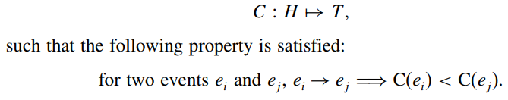
A framework for a system of logical clocks : definition
A system of logical clocks consists of a time domain T and a logical clock C
Elements of T form a partially ordered set over a relation <
This relation is usually called the happened before or causal precedence.
This relation is analogous to the earlier than relation provided by the physical time.
The logical clock C is a function that maps an event e in a distributed system to an element in the time domain T, denoted as C(e) and called the timestamp of e, and is defined as follows:

Slide 12
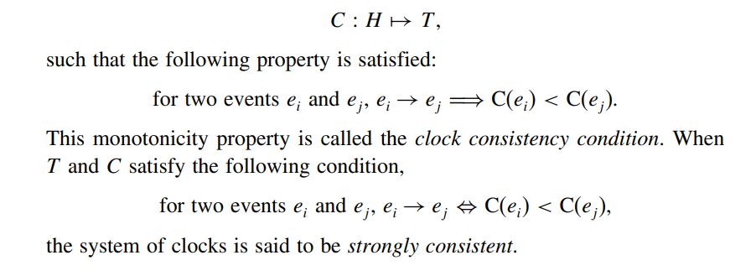
A framework for a system of logical clocks

Slide 13
Implementing logical clocks
Implementation of logical clocks -> two issues
Data structures local to every process to represent logical time
A Protocol (set of rules) to update the data structures to ensure the consistency condition.

Slide 14
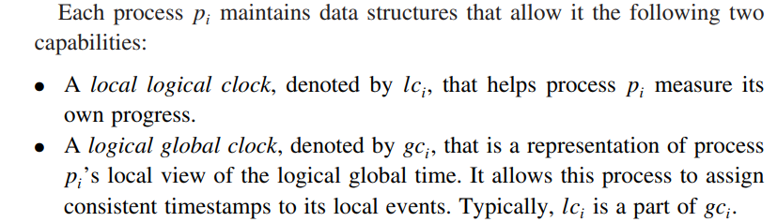
Implementing logical clocks contd…

Slide 15
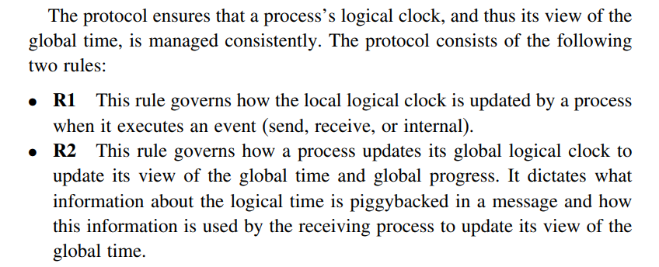
Implementing logical clocks contd…

Slide 16
Scalar Time
Scalar time representation -> proposed by Lamport in 1978
An attempt to totally order events in a distributed system
Time domain in this representation is the set of non-negative integers
The logical local clock of a process p_{i} and its local view of the global time are squashed into one integer variable C_{i}.
Rules R1 and R2 to update the clocks are as follows:

Slide 17
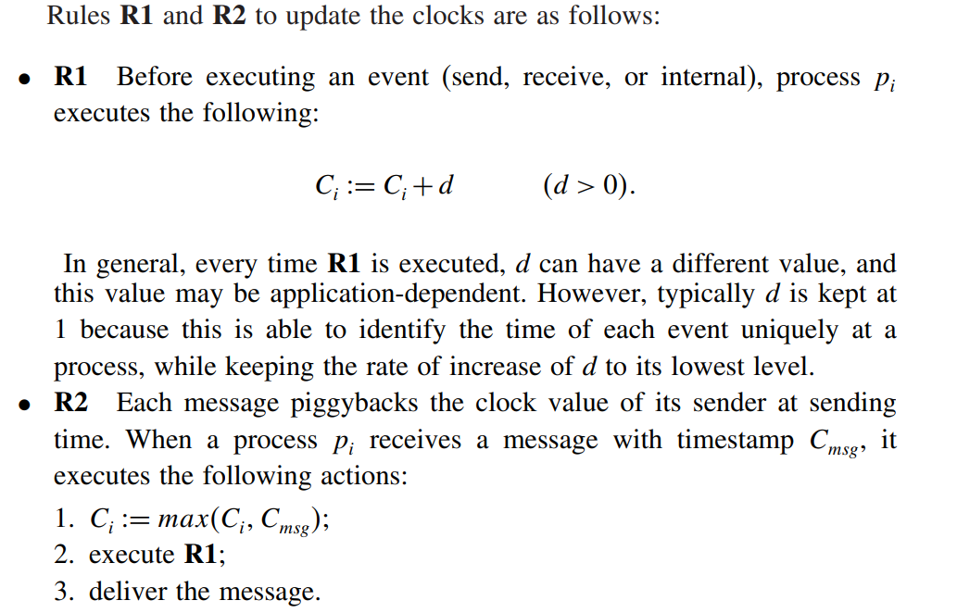
Scalar Time

Slide 18
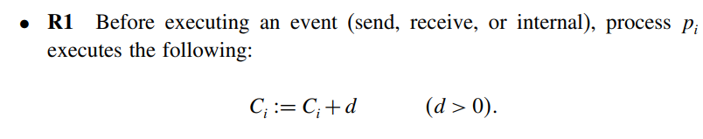
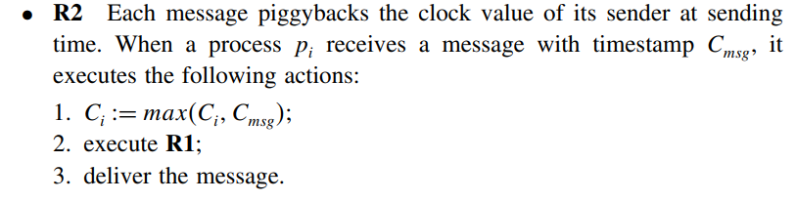
SCALAR TIME
Rules R1 and R2 to update the clocks are as follows:

Slide 19
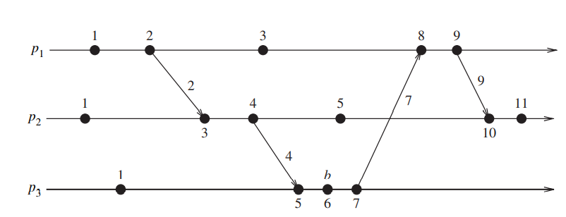
Figure shows evolution of scalar time with d=1

Slide 20
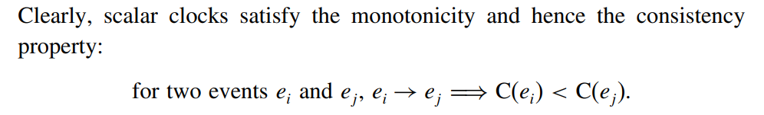
Scalar Time
Basic properties
Consistency property
2. Total Ordering
Scalar clocks can be used to totally order events in a distributed system
The main problem in totally ordering events is that two or more events at different processes may have an identical timestamp.

Slide 21

Scalar Time
for two events
a tie-breaking mechanism is needed to order such events
A tie is broken as follows:
Process identifiers are linearly ordered and a tie among events with identical scalar timestamp is broken on the basis of their process identifiers.
The lower the process identifier in the ranking, the higher the priority.
The timestamp of an event is denoted by a tuple (t, i) where t is its time of occurrence and i is the identity of the process where it occurred.

Slide 22
Scalar Time
3. Event counting
If the increment value d =1, the scalar time has the following property:
if event e has a timestamp h, then h-1 represents the minimum logical duration, counted in units of events, required before producing the event e;
We call it the height of the event e.
i.e., h-1 events have been produced sequentially before the event e
regardless of the processes that produced these events.
For e.g. five events precede event b on the longest causal path ending at b.

Slide 23
Scalar Time

Slide 24

Scalar Time
4. No strong consistency
The system of scalar clocks is not strongly consistent; that is, for two events e_{i} and e_{j}
the third event of process P₁ has smaller scalar Timestamp than the third event of process P₂. However, the former did not happen before the latter.
The reason that scalar clocks are not strongly consistent is that the logical local clock and logical global clock of a process are squashed into one, resulting in the loss causal dependency information among events at different processes.

Slide 25
Vector Time
The system of vector clocks was developed independently by Fidge , Mattern , and Schmuck .
In the system of vector clocks, the time domain is represented by a set of n-dimensional non-negative integer vectors.
A vector clock is a data structure used for determining the partial ordering of events in a distributed system and detecting causality violations
Vector Clocks are used in a distributed systems to determine whether pairs of events are causally related

Slide 26
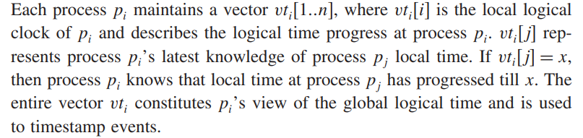

Slide 27
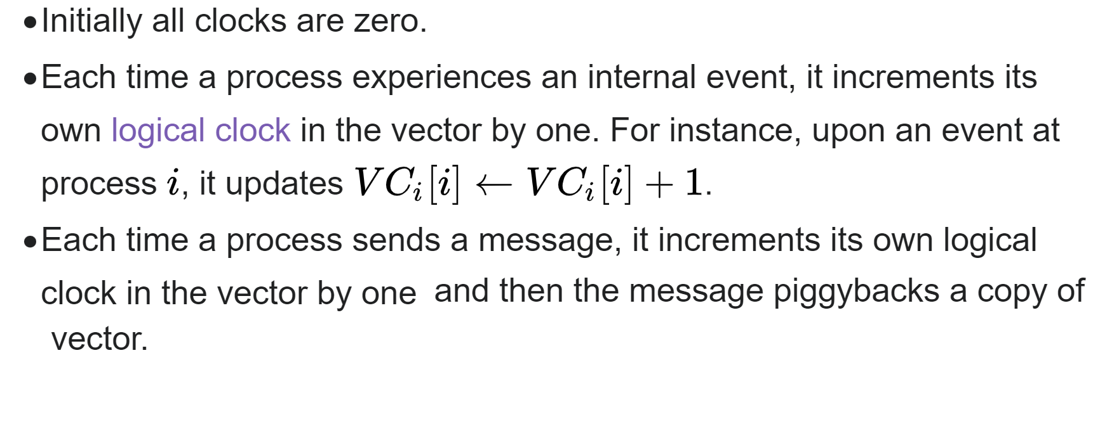
Vector Time

Slide 28
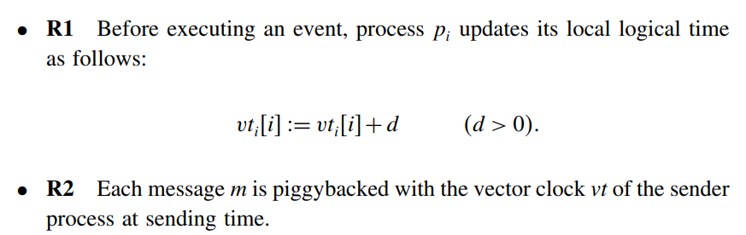
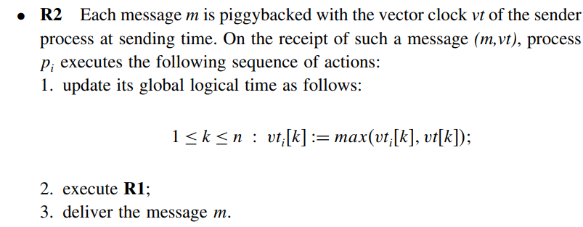
Vector Time

Slide 29
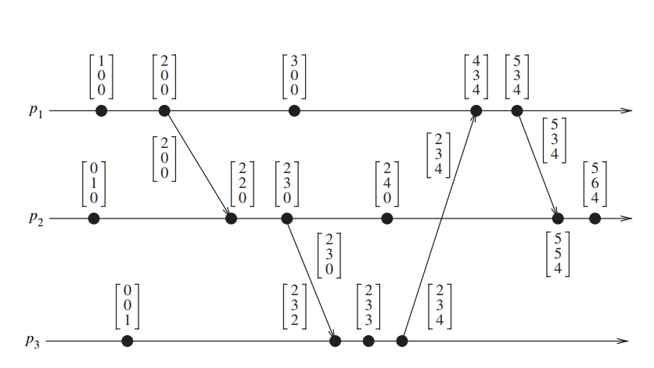
Vector Time

Slide 30
Basic properties Vector Time
Isomorphism
relation “→” induces a partial order on the set of events that are produced by a distributed execution.
If events in a distributed system are time stamped using a system of vector clocks, we have the following property.

Slide 31
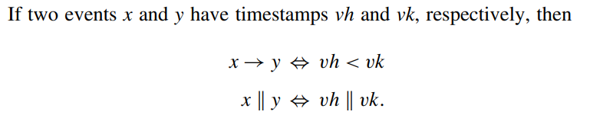
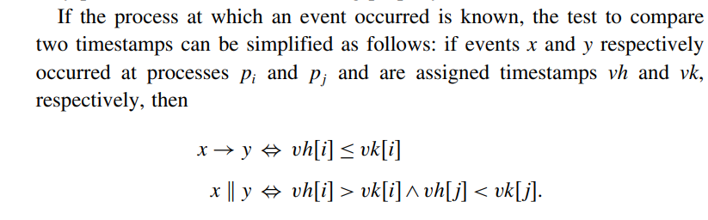
Vector Time

Slide 32
Strong consistency
The system of vector clocks is strongly consistent; i.e. by examining the vector timestamp of two events, we can determine if the events are causally related

Slide 33
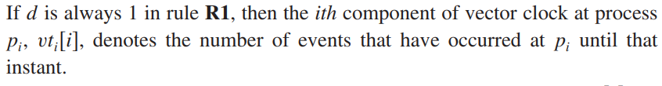


3. Event counting

Slide 34
Vector Time :Applications
Since vector time tracks causal dependencies exactly, it finds a wide variety of applications.
distributed debugging,
implementations of causal ordering communication
causal distributed shared memory,
establishment of global breakpoints
determining the consistency of checkpoints in optimistic recovery

Slide 35
Leader election algorithm
An algorithm for choosing a unique process to play a particular role (coordinator) is called an election algorithm.
All the processes should agree on the choice.
If the process that plays the role of server wishes to retire then another election is required to choose a replacement.
We say that a process calls the election if it takes an action that initiates a particular run of the election algorithm.
At any point in time, a process Pi is either a participant – meaning that it is engaged in some run of the election algorithm – or a non-participant – meaning that it is not currently engaged in any election.

Slide 36
Two Election Algorithms
● A ring-based election algorithm
● Bully algorithm

Slide 37
1. A ring-based election algorithm
Each process p i has a communication channel to the next process in the ring, p ( i + 1) mod N ,
All messages are sent clockwise around the ring.
The goal of this algorithm is to elect a single process called the coordinator,
Initially, every process is marked as a non-participant in an election.
Any process can begin an election. It proceeds by marking itself as a participant, placing its identifier in an election message and sending it to its clockwise neighbour.
When a process receives an election message, it compares the identifier in the message with its own.
If the arrived identifier is greater, then it forwards the message to its neighbour.

Slide 38
If the arrived identifier is smaller and the receiver is not a participant, then it substitutes its own identifier in the message and forwards it; but it does not forward the message if it is already a participant.
On forwarding an election message in any case, the process marks itself as a participant.
If, the received identifier is that of the receiver itself, then this process’s identifier must be the greatest, and it becomes the coordinator.
The coordinator marks itself as a non-participant once more and sends an elected message to its neighbour, announcing its election and enclosing its identity

Slide 39
A ring-based election in progress participant. Any process can begin an election.
1. Initially, every process is marked as non-
2. The starting process marks itself as participant
and place its identifier in a message to its neighbour.
A process receives a message and compare it with its own. If the arrived identifier is larger, it passes on the message.
If arrived identifier is smaller and receiver is not
a participant, substitute its own identifier in the
3
17
4
24
9
message and forward if. It does not forward the
message if it is already a participant.
1
5. On forwarding of any case, the process marks
itself as a participant.
15
If the received identifier is that of the receiver itself, then this process’s identifier must be the greatest, and it becomes the coordinator.
The coordinator marks itself as non-participant, set elected_{i} and sends an elected message to its neighbour enclosing its ID.
When a process receives elected message, it marks itself as a non-participant, sets its variable elected_{i} and forwards the message.
28
24

Slide 40
2. The bully algorithm
Process with highest id will be the coordinator
There are three types of message in this algorithm:
an election message is sent to announce an election;
an answer message is sent in response to an election message
a coordinator message is sent to announce the identity of the elected process.
The process that knows it has the highest identifier can elect itself as the coordinator simply by sending a coordinator message to all processes with lower identifiers.
A process with a lower identifier can begin an election by sending an election message to those processes that have a higher identifier and awaiting answer messages in response.

Slide 41
If none arrives within time T, the process considers itself the coordinator and sends a coordinator message to all processes with lower identifiers announcing this.
Otherwise, the process waits a further period T for a coordinator message to arrive from the new coordinator.
If a process p i receives a coordinator message, it sets its variable elected i to the identifier of the coordinator contained within it and treats that process as the coordinator.
If a process receives an election message, it sends back an answer message and begins another election – unless it has begun one already.

Slide 42
When a process, P, notices that the coordinator is no longer responding to requests, it initiates an election.
● P sends an ELECTION message to all processes with higher no.
● If no one responds, P wins the election and becomes a coordinator.
● If one of the higher-ups answers, it takes over. P’ s job is done.
When a process gets an ELECTION message from one of its lower-numbered colleagues:
● Receiver sends an OK message back to the sender to indicate that he is alive and will take over.

Slide 43
● Receiver holds an election, unless it is already holding one.
● Eventually, all processes give up but one, and that one is the new coordinator.
● The new coordinator announces its victory by sending all processes a message telling them that starting immediately it is the new coordinator.
If a process that was previously down comes back:
● It holds an election.
● If it happens to be the highest process currently running, it will win the election and take over the coordinator’ s job.
● Biggest guy” always wins and hence the name “ bully” algorithm.

Slide 44

The bully algorithm
ele cti on
The process begins an election by sending an election message to these processes that have a higher ID and awaits an answer in response.
If none arrives within time T, the
process considers itself the coordinator
ele cti on
C
Stag e 1
p
1
an swe r
p
2
an swe r
p
p
4
3
ele cti on
ele cti on
ele cti on
C
and sends coordinator message to all
Stag e 2
processes with lower identifiers.
p₁
p
an swe r
p
3
p
4
2
3. Otherwise, it waits a further time T’ for
coordinator message to arrive. If none,
tim eou t
begins another election.
Stag e 3
If a process receives a coordinator message, it sets its variable elected_{i} to be the coordinator ID.
If a process receives an election message, it sends back an answer message and begins another election unless it has begun one already.
p
1
p
2
p
p
4
3
Eventu ally.....
coord inat or
C
Stag e 4
p
1
p
2 3
p
p
4

Slide 45
Ring algorithm – work out
In a ring topology 7 processes are connected with different ID’s as shown: P20->P5->P10->P18->P3->P16->P9 If process P10 initiates election after how many message passes will the coordinator be elected and known to all the processes. What modification will take place to the election message as it passes through all the processes?
Calculate total number of election messages and coordinator messages

Slide 46
P20
P5
P9
P10
P3
P18
P3

Slide 47
Bully Algorithm – Work out
Pid’s 0,4,2,1,5,6,3,7
P7 was the initial coordinator and crashed
Illustrate Bully algorithm, if P4 initiates election , Calculate total number of election messages and coordinator messages

